Slide 1
Module 1
Introduction to computer graphics

Slide 2


Input / Output Devices
1.1 Input Device
1.2 Output Device

Slide 3
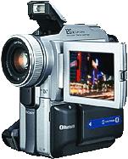
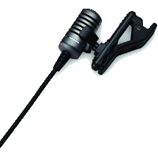
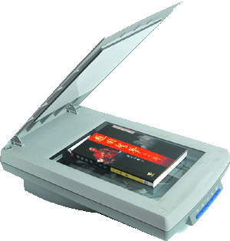

1.1Input Devices
Motivation
Match the following tasks with the suitable input device.
Recording
Photo
Presentation
Speaking
Photo-editing
Sights
Video-taking
Text

Slide 4
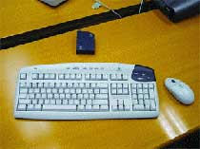

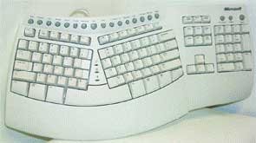
1.1Input Devices
Keyboard
Keyboard is made up of character, numerical and functional keys, it is the most common input device
Multimedia Keyboard
Wireless Keyboard
Virtual Keyboard
Ergonomic Keyboard

Slide 5
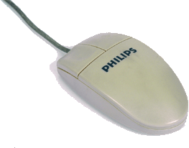

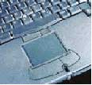
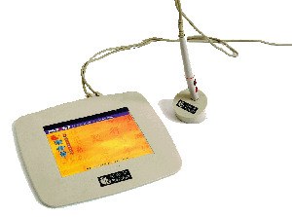
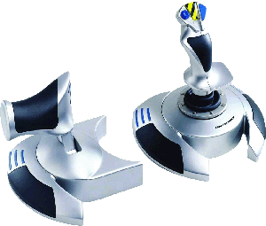

1.1Input Devices
Pointing Devices
Mouse, Trackball, Touchpad and Digitising Table are common pointing devices that will help users operate a computer more easily

Slide 6
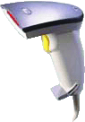
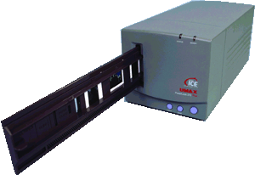
1.1Input Devices
Scanner
Scanner is a device used to convert a still image into a digital one. It can read text or illustrations printed on paper and translate the information into a form the computer can use
Film scanner
Bar code reader
Flatbed scanner

Slide 7
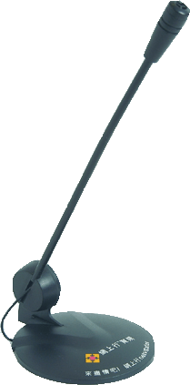
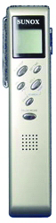

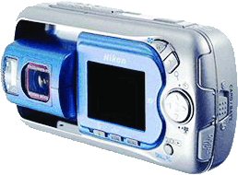
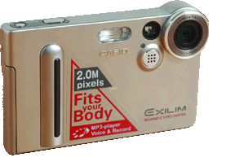
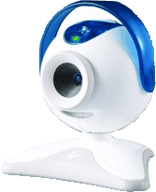
1.1Input Devices
Sound Input Tool
Digital Camera
Digital Video Camera
Digital recorder
A Speech Recognition System
Microphone
Web Camera
Digital Video Camera

Slide 8
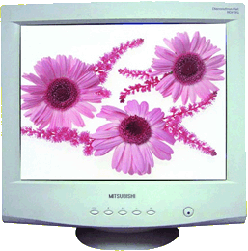
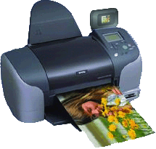
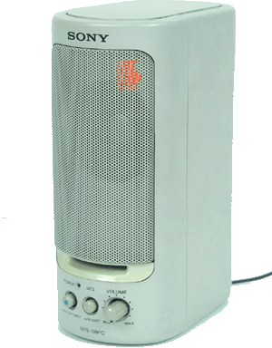
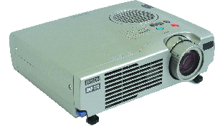
1.2 Output Device
Motivation
Match the following tasks with the suitable output device:
Printing a
photo
Speaking
Presenting
a report
Photo
Presentation
slide
Playing a
video
Playing a
speech
Visual video

Slide 9


1.2 Output Device
Monitor
‧There are two main types of monitor, namely the CRT (Cathode Ray Tube) monitor and the LCD (Liquid Crystal Display) monitor.
‧They can show the data processed by the computer in the form of text, images or visual information.
‧The output on the monitor is only temporary and can only be viewed on the computer screen.

Slide 10
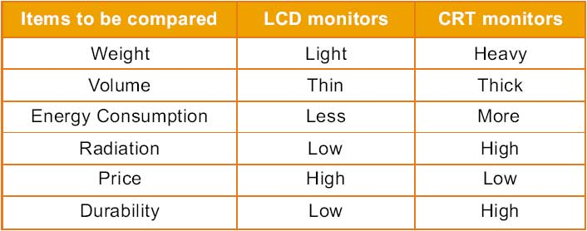
1.2 Output Device
LCD monitors and CRT monitors are compared in the following table:

Slide 11
LED monitor
Short for light-emitting diode monitor, an LED monitor or LED display is a flat screen, flat panel computer monitor or television. It has a very short depth and is light in terms of weight. The actual difference between this and a typical LCDmonitor is the backlighting. The first LCD monitors used CCFLinstead of LEDs to illuminate the screen.
LED monitor advantages
LED monitors offer many benefits when compared to those that are CCFL lit including:
Often less expensive.
Overall more reliable.
They run at a lower temperature, and consume much less power, as few as 20 watts.
Higher dynamic contrast ratio.
Longer lifespan and less environmental impact.

Slide 12
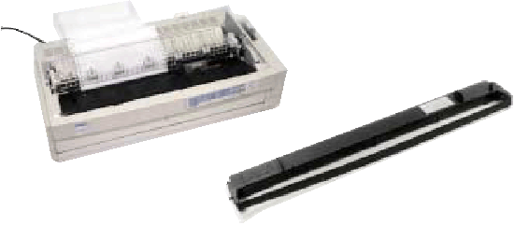
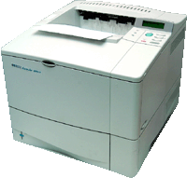
1.2 Output Device
Printer
‧A printer can place text or graphics onto a paper or a slide, which is known as a hard copy.
‧Three type of printer：Dot-matrix Printer, InkJet Printer and Laser Printer
Laser Printer
Dot-matrix Printer
InkJet Printer

Slide 13
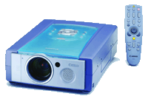
1.2 Output Device
Projector
Speaker

Slide 14

CRT

Slide 15
Scan conversion definition
It is a process of representing graphics objects a collection of pixels.
The graphics objects are continuous.
The pixels used are discrete.
Each pixel can have either on or off state.
The circuitry of the video display device of the computer is capable of converting binary values (0, 1) into a pixel on and pixel off information.
0 is represented by pixel off. 1 is represented using pixel on.
Any model of graphics can be reproduced with a dense matrix of dots or points.

Slide 16
Examples of objects which can be scan converted
Point
Line
Sector
Arc
Ellipse
Rectangle
Polygon
Characters
Filled Regions

Slide 17
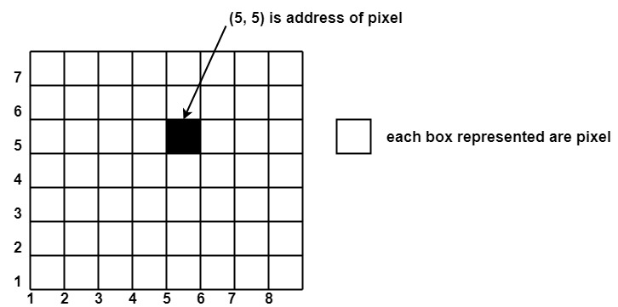
Pixel or Pel
The term pixel is a short form of the picture element.
It is also called a point or dot.
It is the smallest picture unit accepted by display devices.
A picture is constructed from hundreds of such pixels.
Pixels are generated using commands.
Lines, circle, arcs, characters; curves are drawn with closely spaced pixels. To display the digit or letter matrix of pixels is used.
The closer the dots or pixels are, the better will be the quality of picture. Closer the dots are, crisper will be the picture. Picture will not appear jagged and unclear if pixels are closely spaced. So the quality of the picture is directly proportional to the density of pixels on the screen.
Pixels are also defined as the smallest addressable unit or element of the screen. Each pixel can be assigned an address as shown in fig:

Slide 18
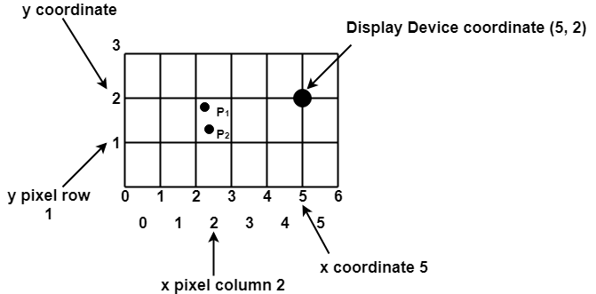
Scan Converting a Point
Each pixel on the graphics display does not represent a mathematical point. Instead, it means a region which theoretically can contain an infinite number of points. Scan-Converting a point involves illuminating the pixel that contains the point.
Example: Display coordinates points Scan Converting a Point as shown in fig would both be represented by pixel (2, 1). In general, a point p (x, y) is represented by the integer part of x & the integer part of y that is pixels [(INT (x), INT (y).

Slide 19
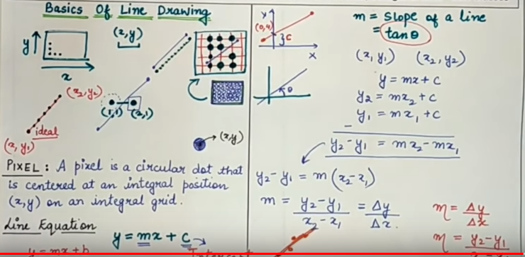

Slide 20
The process of converting is also called as rasterization. The algorithms implementation varies from one computer system to another computer system. Some algorithms are implemented using the software. Some are performed using hardware or firmware. Some are performed using various combinations of hardware, firmware, and software.

Slide 21
Raster Scan Display

Slide 24
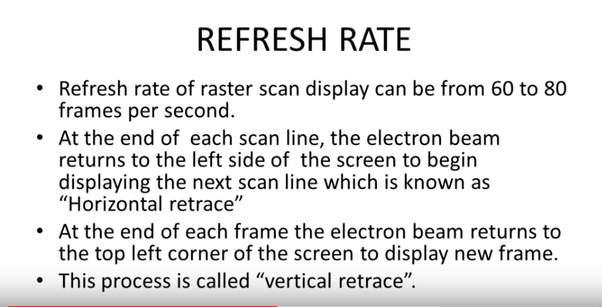

Slide 27
Random Scan Display(Vector Scan Display)

Slide 29
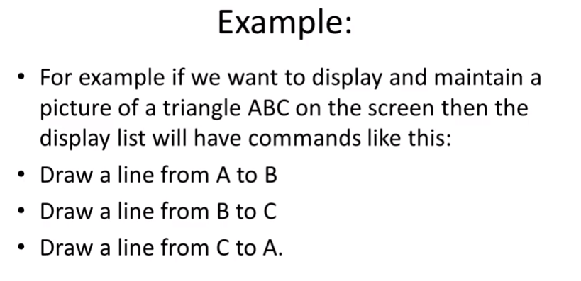

Slide 30
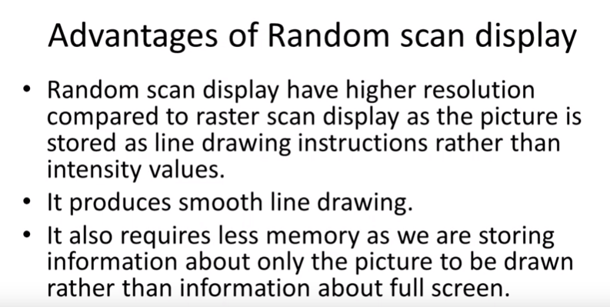

Slide 31
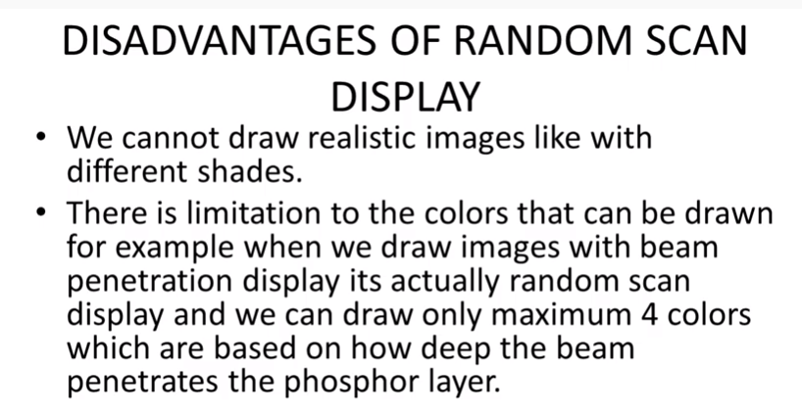

Slide 32
Line Drawing Algorithms
A line in Computer graphics is a portion of straight line that extends indefinitely in opposite direction.
It is defined by its two end points.
Its density should be independent of line length.
the slope intercept equation for a line:
y = mx + b (1)
where, m = Slope of the line
b = the y intercept of a line

Slide 33
The two endpoints of a line segment are specified at positions (x1,y1) and (x2,y2).
y
P2(x2,y2)
P1(x1,y1)
b
0
x

Slide 34
We can determine the value for slope m & b intercept as
m = y2-y1/x2-x1
i.e. m= Δy/ Δx (2)

Slide 35
Example 1 The endpoints of line are(0,0) & (6,18). Compute each value of y as x steps from 0 to 6 and plot the result.
Solution : Equation of line is y= mx +b
m = y2-y1/x2-x1= 18-0/6-0 = 3
Next the y intercept b is found by plugging y1& x1 into the equation y = 3x + b,
0 = 3(0) + b. Therefore, b=0, so the equation for the line is y= 3x.

Slide 36
The challenge is to find a way to calculate the next x,y position by previous one as quickly as possible.

Slide 37
DDA Algorithm
The Digital differential analyzer (DDA) algorithm is an incremental scan-conversion method.
Such an approach is characterized by performing calculations at each step using results from the preceding step.

Slide 38
Given-
Starting coordinates = (X₀, Y₀)
Ending coordinates = (X_{n}, Y_{n})
The points generation using DDA Algorithm involves the following steps-
Step-01:
Calculate ΔX, ΔY and M from the given input.
These parameters are calculated as-
ΔX = X_{n} – X₀
ΔY =Y_{n} – Y₀
M = ΔY / ΔX

Slide 39
Step-02:
Find the number of steps or points in between the starting and ending coordinates.
if (absolute (ΔX) > absolute (ΔY))
Steps = absolute (ΔX);
else
Steps = absolute (ΔY);

Slide 40
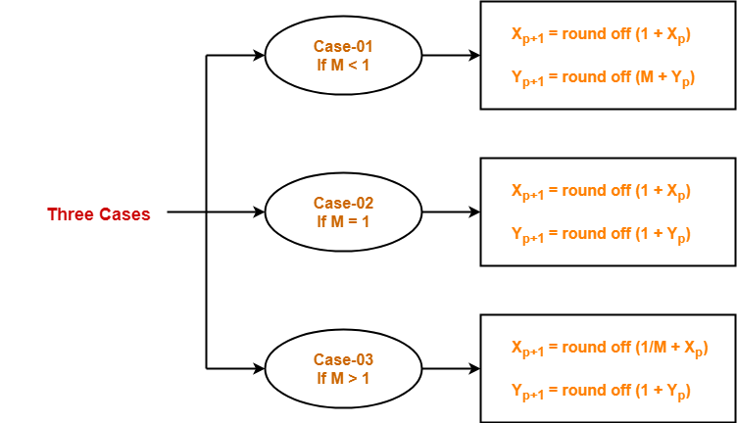
Step-03:
Suppose the current point is (X_{p}, Y_{p}) and the next point is (X_{p+1}, Y_{p+1}).
Find the next point by following the below three cases-

Slide 41
Step-04:
Keep repeating Step-03 until the end point is reached or the number of generated new points (including the starting and ending points) equals to the steps count.

Slide 42
Step1: Start Algorithm
Step2: Declare x1,y1,x2,y2,dx,dy,x,y as integer variables.
Step3: Enter value of x1,y1,x2,y2.
Step4: Calculate dx = x2-x1
Step5: Calculate dy = y2-y1
Step6: If ABS (dx) > ABS (dy)
Then step = abs (dx)
Else
Step7: xinc=dx/step
yinc=dy/step
assign x = x1
assign y = y1
Step8: Set pixel (x, y)
Step9: x = x + xinc
y = y + yinc
Set pixels (Round (x), Round (y))
Step10: Repeat step 9 until x = x2
Step11: End Algorithm

Slide 43
Limitations of DDA:
The rounding operation & floating point arithmetic are time consuming procedures.
Round-off error can cause the calculated pixel position to drift away from the true line path for long line segment.

Slide 44
Bresenham’s Line drawing Algorithm
Bresenham's line algorithm is a line drawing algorithm that determines the points of an n-dimensional raster that should be selected in order to form a close approximation to a straight line between two points.
It is commonly used to draw line primitives in a bitmap image (e.g. on a computer screen), as it uses only integer addition, subtraction and bit shifting, all of which are very cheap operations in standard computer architectures.
It is an incremental error algorithm.
It is one of the earliest algorithms developed in the field of computer graphics.
An extension to the original algorithm may be used for drawing circles.

Slide 45
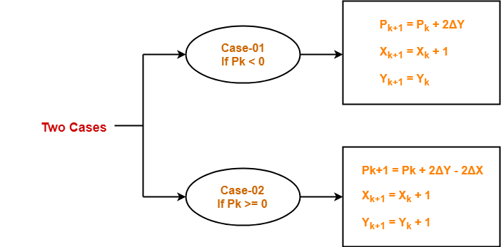
Step-03:
Suppose the current point is (Xk, Yk) and the next point is (Xk+1, Yk+1).
Find the next point depending on the value of decision parameter Pk.
Follow the below two cases-
Procedure-
Given-
Starting coordinates = (X₀, Y₀)
Ending coordinates = (X_{n}, Y_{n})
The points generation using Bresenham Line Drawing Algorithm involves the following steps-
Step-01:
Calculate ΔX and ΔY from the given input.
These parameters are calculated as-
ΔX = X_{n} – X₀
ΔY =Y_{n} – Y₀
Step-02:
Calculate the decision parameter Pk.
It is calculated as-
Pk = 2ΔY – ΔX
Step-04:
Keep repeating Step-03 until the end point is reached or number of iterations equals to (ΔX-1) times.

Slide 46
Bresenham's Line Algorithm:
Step1: Start Algorithm
Step2: Declare variable x1,x2,y1,y2,d,i1,i2,dx,dy
Step3: Enter value of x1,y1,x2,y2
Where x1,y1are coordinates of starting point
And x2,y2 are coordinates of Ending point
Step4: Calculate dx = x2-x1
Calculate dy = y2-y1
Calculate i1=2*dy
Calculate i2=2*(dy-dx)
Calculate d=i1-dx
Step5: Consider (x, y) as starting point and xendas maximum possible value of x.
If dx < 0
Then x = x2
y = y2
xend=x1
If dx > 0
Then x = x1
y = y1
xend=x2
Step6: Generate point at (x,y)coordinates.
Step7: Check if whole line is generated.
If x > = xend
Stop.
Step8: Calculate co-ordinates of the next pixel
If d < 0
Then d = d + i1
If d ≥ 0
Then d = d + i2
Increment y = y + 1
Step9: Increment x = x + 1
Step10: Draw a point of latest (x, y) coordinates
Step11: Go to step 7
Step12: End of Algorithm

Slide 47
Advantages of Bresenham Line Drawing Algorithm-
The advantages of Bresenham Line Drawing Algorithm are-
It is easy to implement.
It is fast and incremental.
It executes fast but less faster than DDA Algorithm.
The points generated by this algorithm are more accurate than DDA Algorithm.
It uses fixed points only.

Slide 48
Disadvantages of Bresenham Line Drawing Algorithm-
The disadvantages of Bresenham Line Drawing Algorithm are-
Though it improves the accuracy of generated points but still the resulted line is not smooth.
This algorithm is for the basic line drawing.
It can not handle diminishing jaggies.

Slide 49
DDA Algorithm | Bresenham's Line Algorithm
1. DDA Algorithm uses floating point, real arithmetic. | 1. Bresenham's Algorithm uses fixed points, integer arithmetic.
2. DDA algorithm uses multiplication and division operations. | 2. Bresenham's Algorithm uses addition and subtraction operations.
3. DDA algorithm is slower than Bresenham's Algorithm because it uses real arithmetic floating point operations. | 3. Bresenham's Algorithm is faster than DDA algorithm because it uses integer arithmetic.
4. DDA algorithm can draw circles and curves with less accuracy. | 4. Bresenham's Algorithm can draw circles and curves with much more accuracy.
5. DDA algorithm is less efficient than Bresenham's Algorithm. | 5. Bresenham's Algorithm is more efficient than DDA Algorithm.
6. DDA algorithm round-off the co-ordinates to integer that is nearest to the line. | 6. Bresenham's Algorithm doesn't round-off the co-ordinates.

Slide 50
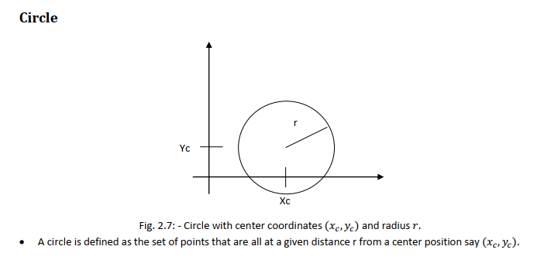

Slide 51
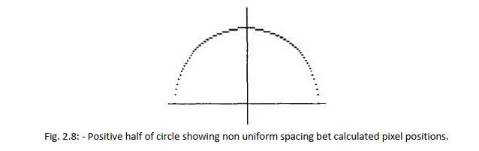

Slide 52
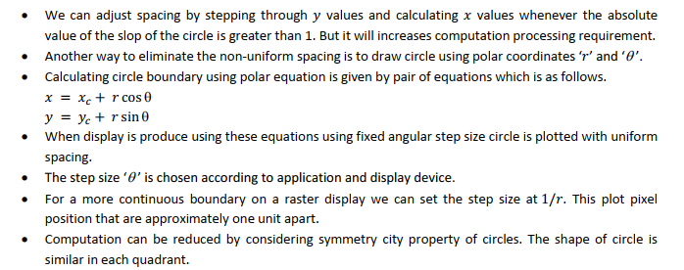

Slide 53
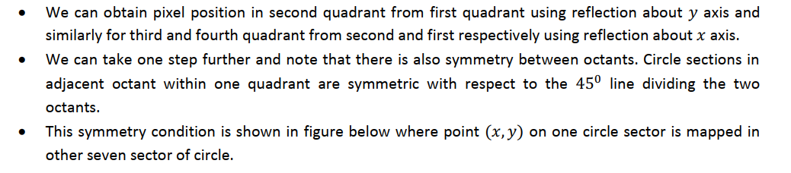
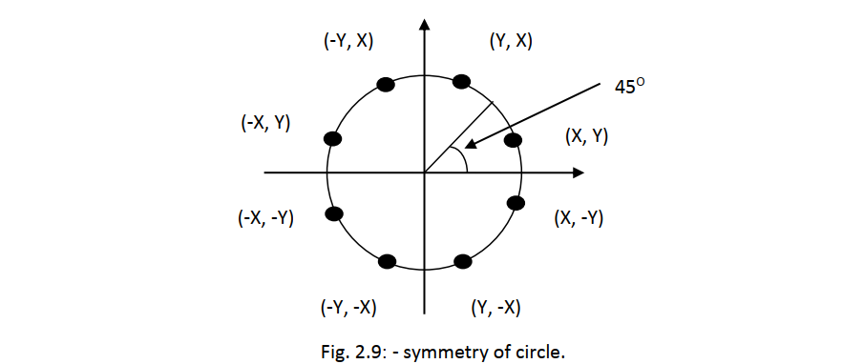

Slide 55
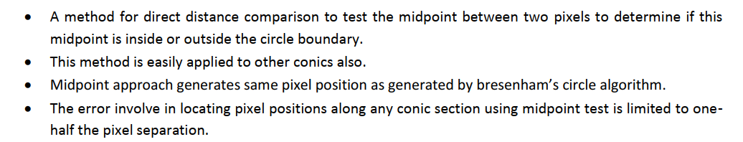

Slide 56
Bresenham Circle Drawing Algorithm
Given the centre point and radius of circle,
Bresenham Circle Drawing Algorithm attempts to generate the points of one octant.
The points for other octacts are generated using the eight symmetry property.

Slide 57
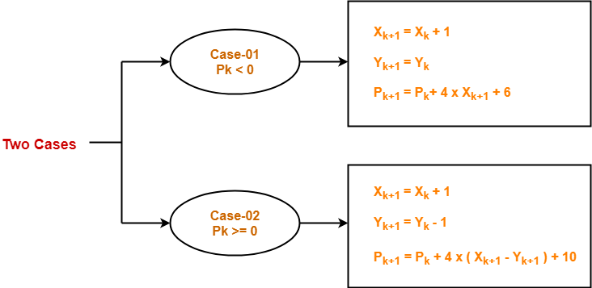
Step-03:
Suppose the current point is (Xk, Yk) and the next point is (Xk+1, Yk+1).
Find the next point of the first octant depending on the value of decision parameter Pk.
Follow the below two cases-
Procedure-
Given-
Centre point of Circle = (X₀, Y₀)
Radius of Circle = R
The points generation using Bresenham Circle Drawing Algorithm involves the following steps-
Step-01:
Assign the starting point coordinates (X₀, Y₀) as-
X₀ = 0
Y₀ = R
Step-02:
Calculate the value of initial decision parameter P₀ as-
P₀ = 3 – 2 x R

Slide 58
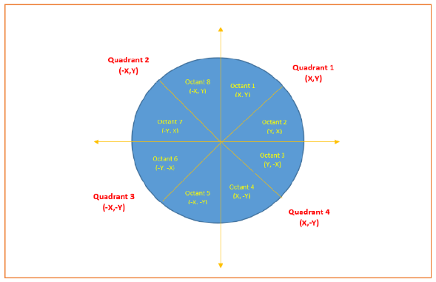
Step-04:
If the given centre point (X0, Y0) is not (0, 0), then do the following and plot the point-
Xplot = Xc + X0
Yplot = Yc + Y0
Here, (Xc, Yc) denotes the current value of X and Y coordinates.
Step-05:
Keep repeating Step-03 and Step-04 until Xplot => Yplot.
Step-06:
Step-05 generates all the points for one octant.
To find the points for other seven octants, follow the eight symmetry property of circle.
This is depicted by the following figure-

Slide 59
Given the centre point coordinates (0, 0) and radius as 8, generate all the points to form a circle.
Step-03:
As Pinitial < 0, so case-01 is satisfied.
Thus,
Xk+1 = Xk + 1 = 0 + 1 = 1
Yk+1 = Yk = 8
Pk+1 = Pk + 4 x Xk+1 + 6 = -13 + (4 x 1) + 6 = -3
Solution-
Given-
Centre Coordinates of Circle (X0, Y0) = (0, 0)
Radius of Circle = 8
Step-01:
Assign the starting point coordinates (X0, Y0) as-
X0 = 0
Y0 = R = 8
Step-02:
Calculate the value of initial decision parameter P0 as-
P0 = 3 – 2 x R
P0 = 3 – 2 x 8
P0 = -13
Step-04:
This step is not applicable here as the given centre point coordinates is (0, 0).
Step-05:
Step-03 is executed similarly until Xk+1 >= Yk+1 as follows-

Slide 60
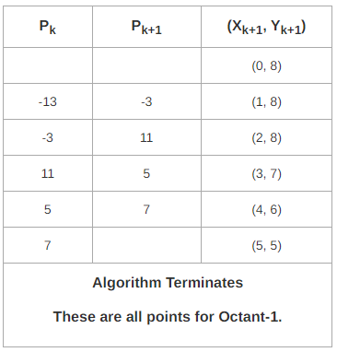
Now, the points for rest of the part are generated by following the signs of other quadrants.
The other points can also be generated by calculating each octant separately.
Here, all the points have been generated with respect to quadrant-1-

Slide 61
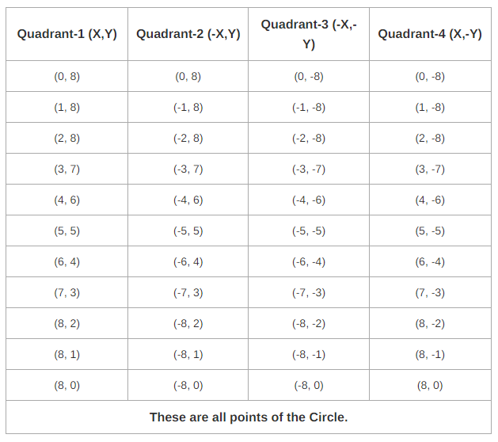

Slide 62
Steps:
Step 1 : Set initial values of (xc, yc) and (x, y)
Step 2 : Calculate decision parameter d to d = 3 – (2 * r).
Step 3 : call displayBresenhmCircle(int xc, int yc, int x, int y) method to display initial(0,r) point.
Step 4 : Repeat steps 5 to 8 until x < = y
Step 5 : Increment value of x.
Step 6 : If d < 0, set d = d + (4*x) + 6
Step 7 : Else, set d = d + 4 * (x – y) + 10 and decrement y by 1.
Step 8 : call displayBresenhmCircle(int xc, int yc, int x, int y) method.
Step 9 : Exit.

Slide 63
Mid Point Circle Drawing Algorithm
Step-01:
Assign the starting point coordinates (X0, Y0) as-
X0 = 0
Y0 = R
Step-02:
Calculate the value of initial decision parameter P0 as-
P0 = 1 – R
Given-
Centre point of Circle = (X0, Y0)
Radius of Circle = R
The points generation using Mid Point Circle Drawing Algorithm involves the following steps-

Slide 64
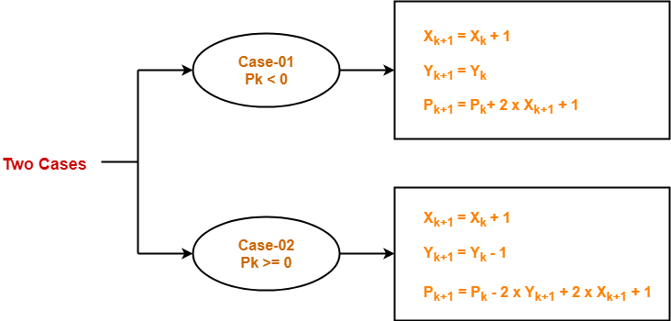
Step-03:
Suppose the current point is (Xk, Yk) and the next point is (Xk+1, Yk+1).
Find the next point of the first octant depending on the value of decision parameter Pk.
Follow the below two cases-
Step-04:
If the given centre point (X0, Y0) is not (0, 0), then do the following and plot the point-
Xplot = Xc + X0
Yplot = Yc + Y0
Here, (Xc, Yc) denotes the current value of X and Y coordinates.
Step-05:
Keep repeating Step-03 and Step-04 until Xplot >= Yplot.
Step-06:
Step-05 generates all the points for one octant.
To find the points for other seven octants, follow the eight symmetry property of circle.

Slide 65
Given the centre point coordinates (0, 0) and radius as 10, generate all the points to form a circle.
Solution-
Given-
Centre Coordinates of Circle (X0, Y0) = (0, 0)
Radius of Circle = 10
Step-01:
Assign the starting point coordinates (X0, Y0) as-
X0 = 0
Y0 = R = 10
Step-02:
Calculate the value of initial decision parameter P0 as-
P0 = 1 – R
P0 = 1 – 10
P0 = -9
Step-03:
As Pinitial < 0, so case-01 is satisfied.
Thus,
Xk+1 = Xk + 1 = 0 + 1 = 1
Yk+1 = Yk = 10
Pk+1 = Pk + 2 x Xk+1 + 1 = -9 + (2 x 1) + 1 = -6

Slide 66
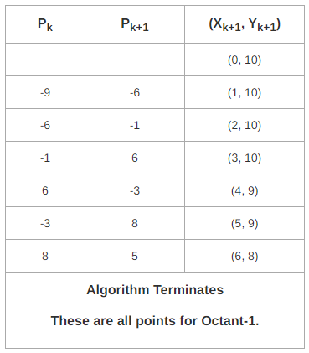
Step-04:
This step is not applicable here as the given centre point coordinates is (0, 0).
Step-05:
Step-03 is executed similarly until Xk+1 >= Yk+1 as follows-
Algorithm Terminates
These are all points for Octant-1.
Algorithm calculates all the points of octant-1 and terminates.

Slide 67
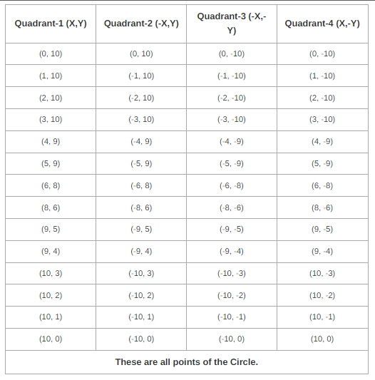

Slide 68
S.NO | DDA Line Algorithm | Bresenham line Algorithm
1. | DDA stands for Digital Differential Analyzer. | While it has no full form.
2. | DDA algorithm is less efficient than Bresenham line algorithm. | While it is more efficient than DDA algorithm.
3. | The calculation speed of DDA algorithm is less than Bresenham line algorithm. | While the calculation speed of Bresenham line algorithm is faster than DDA algorithm.
4. | DDA algorithm is costlier than Bresenham line algorithm. | While Bresenham line algorithm is cheaper than DDA algorithm.
5. | DDA algorithm has less precision or accuracy. | While it has more precision or accuracy.
6. | In DDA algorithm, the complexity of calculation is more complex. | While in this, the complexity of calculation is simple.
7. | In DDA algorithm, optimization is not provided. | While in this, optimization is provided.

Slide 69
INTERPOLATION
Drawing a curve with number of sample points array on a straight line is called as interpolation.
The points provides path to the straight line to generate a curve.

Slide 70
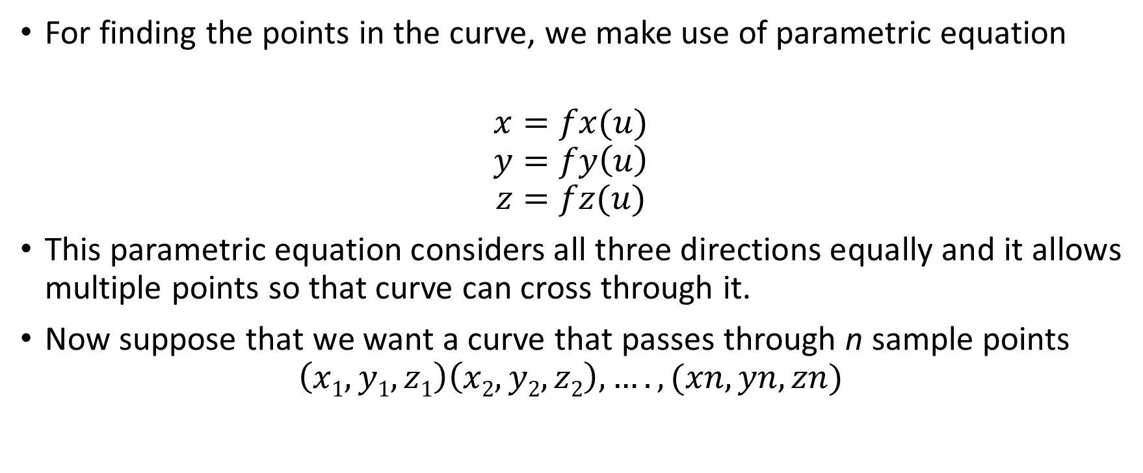
INTERPOLATION
For finding the points in the curve, we make use of parametric equation
$$x=fx(u)$$
$$y=fy\left(u\right)$$
$$z=fz(u)$$
This parametric equation considers all three directions equally and it allows multiple points so that curve can cross through it.
Now suppose that we want a curve that passes through n sample points
$$\left(x1,y1,z1\right)\left(x2,y2,z2\right),….,(xn,yn,zn)$$

Slide 71
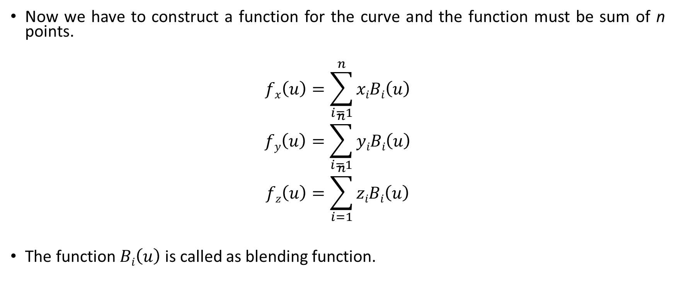
INTERPOLATION
Now we have to construct a function for the curve and the function must be sum of n points.
$$fx\left(u\right)=\sum_{i=1}^{n}{xiBi\left(u\right)}$$
$$fy\left(u\right)=\sum_{i=1}^{n}{yiBi\left(u\right)}$$
$$fz\left(u\right)=\sum_{i=1}^{n}{ziBi\left(u\right)}$$
The function $Bi\left(u\right)$is called as blending function.

Slide 72
INTERPOLATION
To achieve a perfect curve, it must pass through all the sample points.
It means each sample point tries to pull the curve in his direction.
The curve will not pass from the value 0 of u.
So we have develop a blending function such that its value could be 1 for the starting sample point.
So the value of u is -1 for 1st point, 0 for 2nd point and 1 for 3rd point and so on.

Slide 73
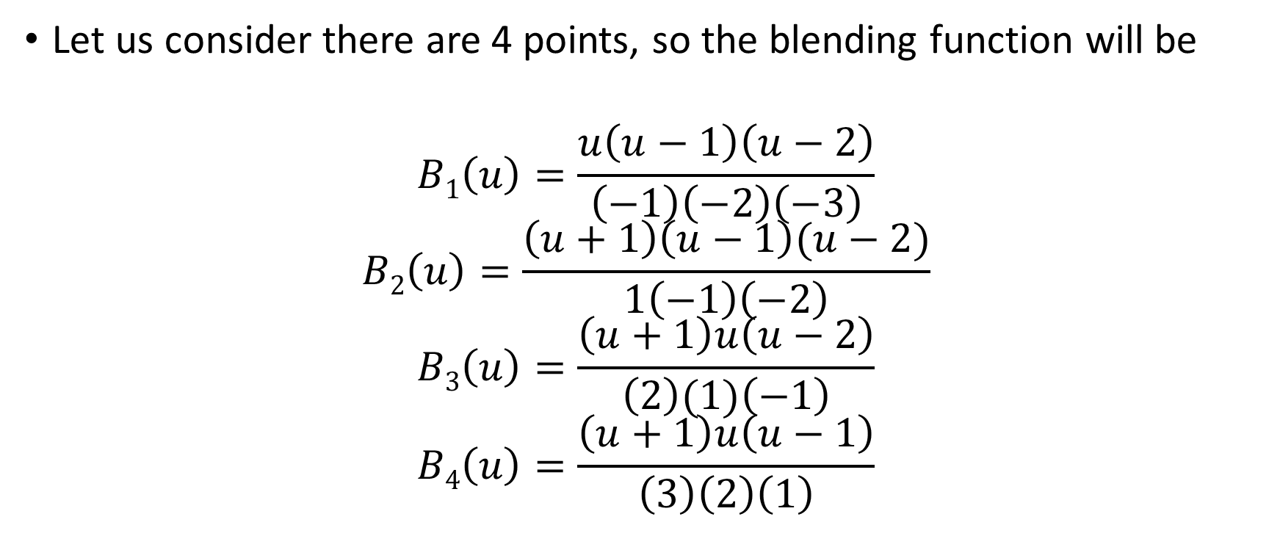
INTERPOLATION
Let us consider there are 4 points, so the blending function will be
$$B1\left(u\right)=\frac{u\left(u−1\right)\left(u−2\right)}{\left(−1\right)\left(−2\right)\left(−3\right)}$$
$$B2\left(u\right)=\frac{\left(u+1\right)\left(u−1\right)(u−2)}{1\left(−1\right)\left(−2\right)}$$
$$B3\left(u\right)=\frac{\left(u+1\right)u\left(u−2\right)}{\left(2\right)(1)\left(−1\right)}$$
$$B4\left(u\right)=\frac{\left(u+1\right)u\left(u−1\right)}{\left(3\right)\left(2\right)\left(1\right)}$$

Slide 74
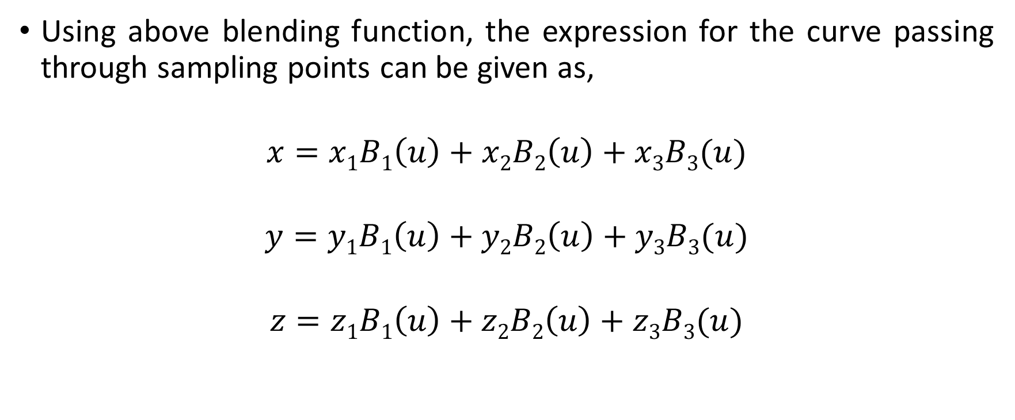
INTERPOLATION
Using above blending function, the expression for the curve passing through sampling points can be given as,
$$x=x1B1\left(u\right)+x2B2\left(u\right)+x3B3(u)$$
$$y=y1B1\left(u\right)+y2B2\left(u\right)+y3B3(u)$$
$$z=z1B1\left(u\right)+z2B2\left(u\right)+z3B3(u)$$

Slide 75
HILBERT’S CURVE
The Hilbert’s curve focuses on drawing a curve in quadrant.
In each approximation the curve is drawn by finding the center points of each quadrant.
Each quadrant is visited only once.
The approximations can be infinite as the curve generation is very easy and simple.

Slide 76
HILBERT’S CURVE
The FIRST approximation

Slide 77
HILBERT’S CURVE
The SECOND approximation
II
III
I
IV

Slide 78
HILBERT’S CURVE
The THIRD approximation

Slide 79

KOCH CURVE
The Koch curve can be drawn by dividing line into 4 equal segments with scaling factor 1/3 and middle two segments are so adjusted that they form adjacent sides of an equilateral triangle.
To apply the second approximation to the Koch curve we have to repeat the above process for each of the four segments.

Slide 80
KOCH CURVE
The resultant curve has more wiggles and its length is 16/9 times the original length.
From the above figures we can easily note following points about the Koch curve :
Each repetition increases the length of the curve by factor 4/3.
Length of curve is infinite.
Unlike Hilbert's curve, it doesn’t fill an area.
It doesn’t deviate much from its original shape.

Slide 81
BEZIER CURVE
Bezier curve is determined by defining a polygon.
The Bezier curve is draw using control points and tangent.
Types of Bezier curve
Simple Line connecting 2 endpoints
A Quadric curve using 3 endpoints
A Cubic curve using 4 endpoints

Slide 82
BEZIER CURVE
Simple Line connecting 2 endpoints
P2
P1

Slide 83
BEZIER CURVE
A Quadric curve using 3 endpoints
P2
P1
P3

Slide 84
BEZIER CURVE
A Cubic curve using 4 endpoints
P2
P3
P1
P4

Slide 85
BEZIER CURVE
PROPERTIES OF BEZIER CURVE
It depends on number of control points
Curve will pass only through end points
Polynomial equation of a curve depends on number of control points.
If n = control points then degree of polynomial is defined as n-1.

Slide 86

BEZIER CURVE
WORKING OF BEZIER CURVE
BLENDING FUNCTION
$$P\left(u\right)=\sum_{i=0}^{n}{Pi Bi,n (u)}$$
$$0≤u≤1$$

Slide 87

BEZIER CURVE
$$Bi,n(u)=c\left(n,i\right) ui\left(1−u\right)n_i$$
$$c\left(n,i\right)=\frac{n!}{i!\left(n−i\right)!}$$
$$Bi,n\left(u\right)=\frac{n!}{i!\left(n−i\right)!} ui\left(1−u\right)n_i$$

Slide 88

BEZIER CURVE
CUBIC BEZIER CURVE : Degree of Polynomial is 3
$$P\left(u\right)=\sum_{i=0}^{n}{Pi Bi,n (u)}$$
$P\left(u\right)=P0B0,3\left(u\right)+$ $P1B1,3\left(u\right)+P2B2,3\left(u\right)+P3B3,3\left(u\right)$
$$B0,3\left(u\right)=c\left(3,0\right).u0.\left(1−u\right)3_0$$
$$=\frac{3!}{0!3!}\left(1−u\right)3=\left(1−u\right)3$$

Slide 89

BEZIER CURVE
$$B1,3\left(u\right)=c\left(3,1\right).u1.\left(1−u\right)3_1$$
$$=3u\left(1−u\right)2$$
$$B2,3\left(u\right)=c\left(3,2\right).u2.\left(1−u\right)3_2$$
$$=3u2\left(1−u\right)$$
$$B3,3\left(u\right)=c\left(3,3\right).u3.\left(1−u\right)3_3$$
$$=u3$$

Slide 90

BEZIER CURVE
$$P\left(u\right)=P0\left(1−u\right)3+P1.3u.\left(1−u\right)2+P2.3u2.\left(1−u\right)+P3.u3$$
$$P\left(ux\right)=P0x0\left(1−u\right)3+P1x1.3u.\left(1−u\right)2+P2x2.3u2.\left(1−u\right)+P3x3.u3$$
$$P\left(uy\right)=P0y0\left(1−u\right)3+P1y1.3u.\left(1−u\right)2+P2y2.3u2.\left(1−u\right)+P3y3.u3$$
$$P\left(uz\right)=P0z0\left(1−u\right)3+P1z1.3u.\left(1−u\right)2+P2z2.3u2.\left(1−u\right)+P3z3.u3$$

Slide 91

BEZIER CURVE
EXAMPLE
Design a Bezier curve controlled by 4 points A (1,1), B (2,3), C (4,3) and D (6,4)
Solution: Control points = 4 and degree of polynomial = 3
P1 = (1,1) , P2 = (2,3), P3 = (4,3) and P4 = (6,4)
$$P\left(u\right)=\sum_{i=0}^{n}{Pi Bi,n (u)}$$

Slide 92

BEZIER CURVE
$$P\left(u\right)=P0\left(1−u\right)3+P1.3u.\left(1−u\right)2+P2.3u2.\left(1−u\right)+P3.u3$$
To find x (u) and y (u)
$$x\left(u\right)=x0\left(1−u\right)3+x1.3u.\left(1−u\right)2+x2.3u2.\left(1−u\right)+x3.u3$$
$$=1\left(1−u\right)3+6u\left(1−u\right)2+12u2\left(1−u\right)+6u3$$
$$y\left(u\right)=y0\left(1−u\right)3+y1.3u.\left(1−u\right)2+y2.3u2.\left(1−u\right)+y3.u3$$
$$=1\left(1−u\right)3+9u\left(1−u\right)2+9u2\left(1−u\right)+4u3$$

Slide 93

BEZIER CURVE
u | x (u) | y (u)
0 | 1 | 1
0.2 | 1.712 | 1.984
0.4 | 2.616 | 2.632
0.6 | 3.664 | 3.088
0.8 | 4.808 | 3.496
1 | 6 | 4
$$0≤u≤1$$

Slide 94
6
5
P4
4
P2
P3
3
2
P1
1
1
2
3
4
5
6

Slide 95
B-SPLINE CURVE
Problems with Bezier curve are
It depends on number of control points (global control)
The degree of polynomial is dependent on control points.
The B-spline curve overcomes these problems, so it is called as local control.
It depends upon the order of the polynomial.
That is it is based on the number of control points and if the order varies then blending function degree will be different.

Slide 96

B-SPLINE CURVE
WORKING OF B-SPLINE CURVE
BLENDING FUNCTION
$$P\left(u\right)=\sum_{i=1}^{n+1}{Pi Ni,k (u)}$$
$$umin≤u≤umax$$
$$2≤k≤n+1$$

Slide 97

B-SPLINE CURVE
$Ni,k\left(u\right)$ is defined as
$$Ni,k\left(u\right)=\frac{\left[\left(u−x1\right)Ni,k−1\left(u\right)\right]}{\left[xi+k−1−xi\right]}+\frac{\left[\left(x1+k−u\right)Ni+1,k−1\left(u\right)\right]}{\left[xi+k−xi+1\right]}$$
Where,
$$Ni,1\left(u\right)=1 ifxi≤u<xi+1, otherwise 0$$
$$xi=0 1≤i≤k$$
$$xi=i−k+1 k≤i≤n$$
$$xi=n−k+2 i>n$$

Slide 98
B-SPLINE CURVE
When we design the B-spline curve we have to evaluate knot.
The knot can be evaluated by using
Uniform
Non-uniform
Open Uniform

